Slide 1
DIRECT CURRENT METERS
An instrument intended for the measurement of electrical quantity in a direct current circuit.
Hans Oersted – discovered the relationship between current and magnetism.
Jacques D’Arsonval – patented the permanent moving coil galvanometer.

Slide 2
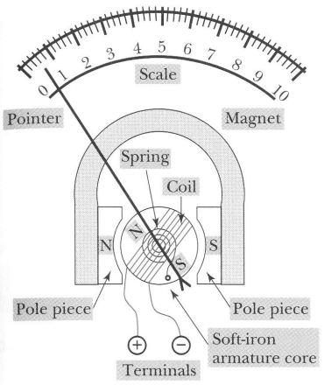
D’Arsonval Meter Movement or Permanent Magnet Moving Coil (PMMC) Meter Movement

Slide 3
The d’Arsonval meter movement is very widely used. It can be used to indicate the value of dc and ac quantity.
Regardless of the units (volt, ohm, etc) for which the scale is calibrated, the moving coil responds to the amount of current through its winding.

Slide 4
When current flows through the coil, the core will rotate. The amount of rotation is proportional to the amount of current flowing through the coil.
The meter requires low current (~50μA) for a full scale deflection, thus consumes very low power (25-200 μW). Its accuracy is about 2% -5% of full scale deflection.

Slide 5
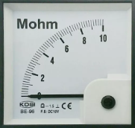
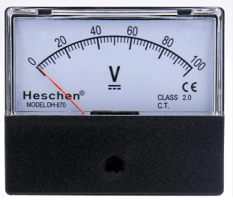
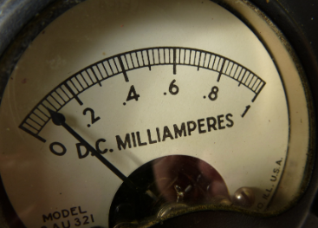
Ohm meter, milliammeter, & voltmeter with deflection type indicators.

Slide 6
DC AMMETER
If a resistor is placed in parallel with the Permanent Magnet Moving Coil (PMMC) galvanometer, then the entire combination acts as dc ammeter.
The parallel resistance, which is used in dc ammeter is also called shunt resistance or shunt. The value of this resistance should be considered small in order to measure the dc current of large value.

Slide 7
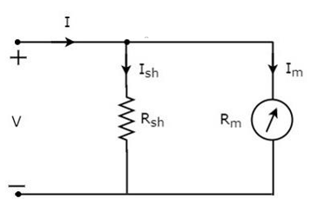
DC AMMETER
Where:
Rsh = shunt resistance
Rm = internal resistance
Ish = shunt current
Im = full scale deflection current
I = full scale deflection current for the ammeter

Slide 8

DC AMMETER
Vm = ImRm
Rsh//Rm
Vsh = Vm ; Ish = I – Im
Rsh = $\frac{Vsh}{Ish}$ = $\frac{ImRm}{Ish}$ = $\frac{Im}{I −Im}Rm$

Slide 9
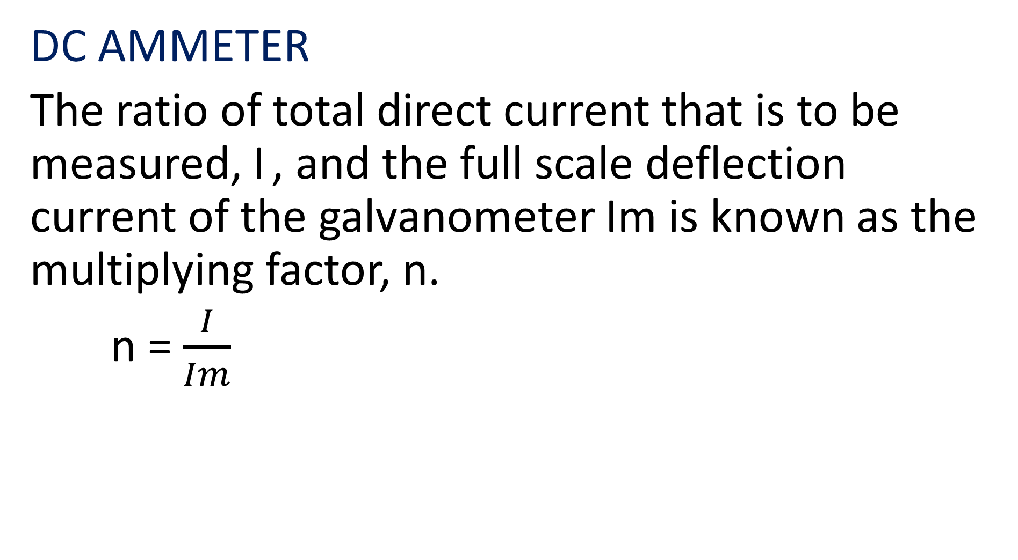
DC AMMETER
The ratio of total direct current that is to be measured, I , and the full scale deflection current of the galvanometer Im is known as the multiplying factor, n.
n = $\frac{I}{Im}$

Slide 10
Example
Calculate the shunt resistance required to convert a 1 mA meter movement with a 100 Ω internal resistance into a 0 – 10 mA movement.
Given:
Im = 1 mA
Rm = 100 Ω
Reqd:
Rsh

Slide 11
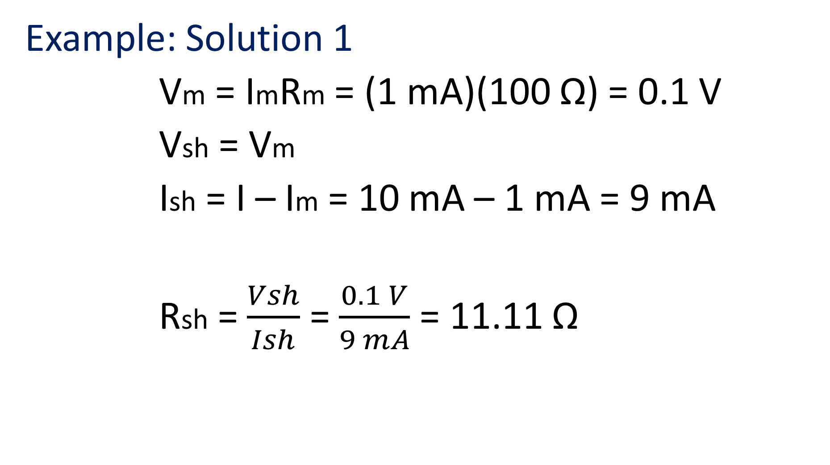
Example: Solution 1
Vm = ImRm = (1 mA)(100 Ω) = 0.1 V
Vsh = Vm
Ish = I – Im = 10 mA – 1 mA = 9 mA
Rsh = $\frac{Vsh}{Ish}$ = $\frac{0.1 V}{9 mA}$ = 11.11 Ω

Slide 12
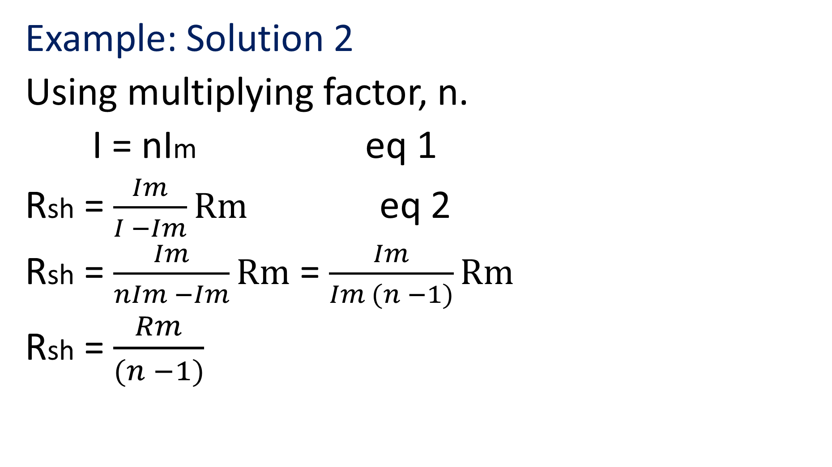
Example: Solution 2
Using multiplying factor, n.
I = nIm eq 1
Rsh = $\frac{Im}{I −Im}Rm$ eq 2
Rsh = $\frac{Im}{nIm −Im}Rm$ = $\frac{Im}{Im (n −1)}Rm$
Rsh = $\frac{Rm}{(n −1)}$

Slide 13
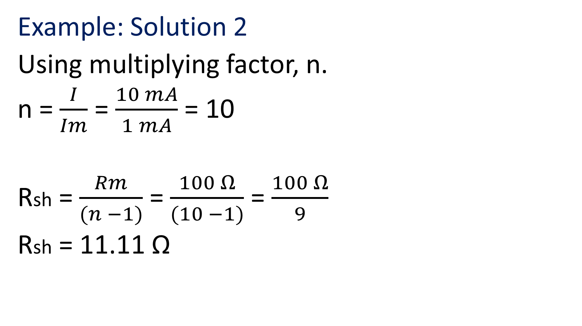
Example: Solution 2
Using multiplying factor, n.
n = $\frac{I}{Im}$ = $\frac{10 mA}{1 mA}$ = 10
Rsh = $\frac{Rm}{(n −1)}$ = $\frac{100 Ω}{(10 −1)}$ = $\frac{100 Ω}{9}$
Rsh = 11.11 Ω

Slide 14
Ayrton Shunt – Universal Shunt
Used on a multiple range ammeter. It eliminates the possibility of the meter movement being in the circuit without any shunt resistance. It can be used with a wide range of meter movement.

Slide 15
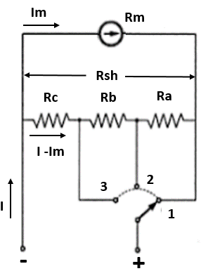

Multi Range Ammeter (series resistors)
n = $\frac{I}{Im}$
Rsh = $\frac{\text{R}\text{m}}{(\text{n}−1)}$
Rsh = Ra + Rb + Rc
An Ammeter using Ayrton shunt

Slide 16
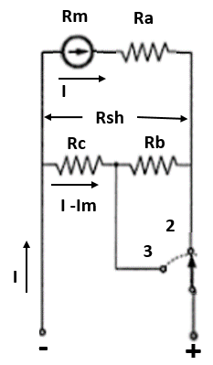
Multi Range Ammeter (series resistors)
If the switch is in the middle position:
Rb + Rc // Rm + Ra
VRb + Rc = VRm + Ra
In current & resistance terms:
(Rb + Rc)(I2 – Im) = Im(Ra + Rm)
Or
I2(Rb + Rc) - Im(Rb + Rc) = Im[Rsh - (Rb + Rc) + Rm]

Slide 17
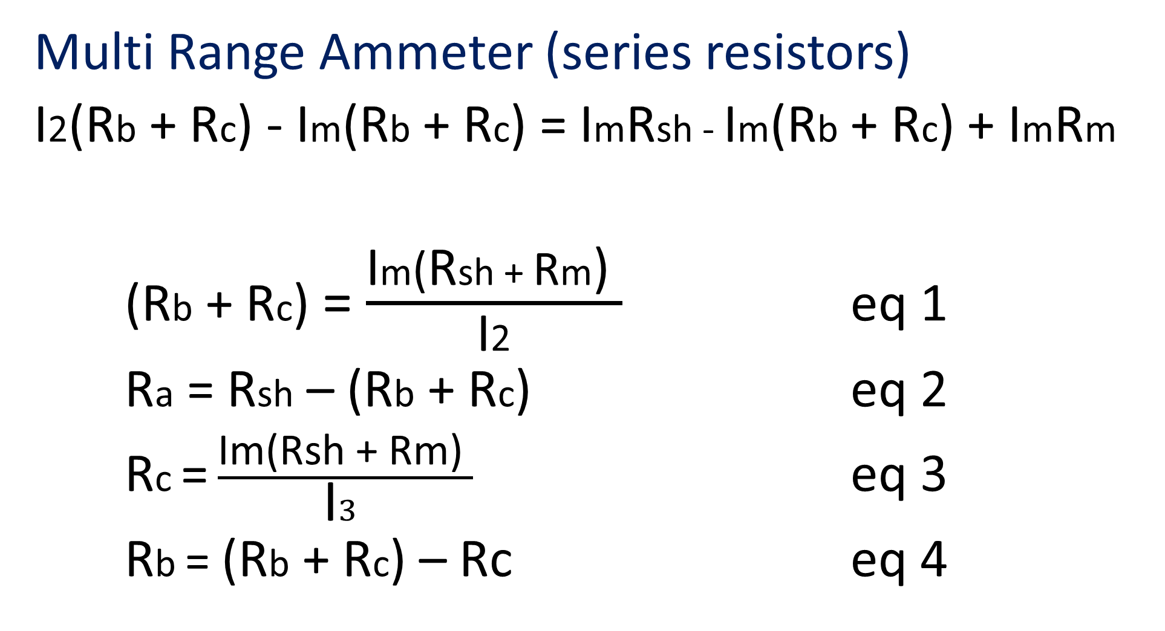
Multi Range Ammeter (series resistors)
I2(Rb + Rc) - Im(Rb + Rc) = ImRsh - Im(Rb + Rc) + ImRm
(Rb + Rc) = $\frac{\text{I}\text{m}\text{(}\text{R}\text{sh}\text{ + }\text{R}\text{m}\text{) }}{\text{I}\text{2}}$ eq 1
Ra = Rsh – (Rb + Rc) eq 2
Rc = $\frac{\text{Im}\text{(}\text{Rsh}\text{ + }\text{Rm}\text{) }}{\text{I}3 }$ eq 3
Rb = (Rb + Rc) – Rc eq 4

Slide 18
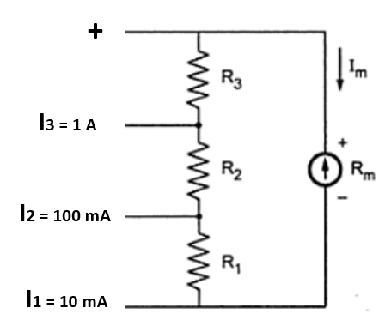
Example
Calculate the value of the shunt resistors if Im = 100 μA and Rm = 1kΩ

Slide 19
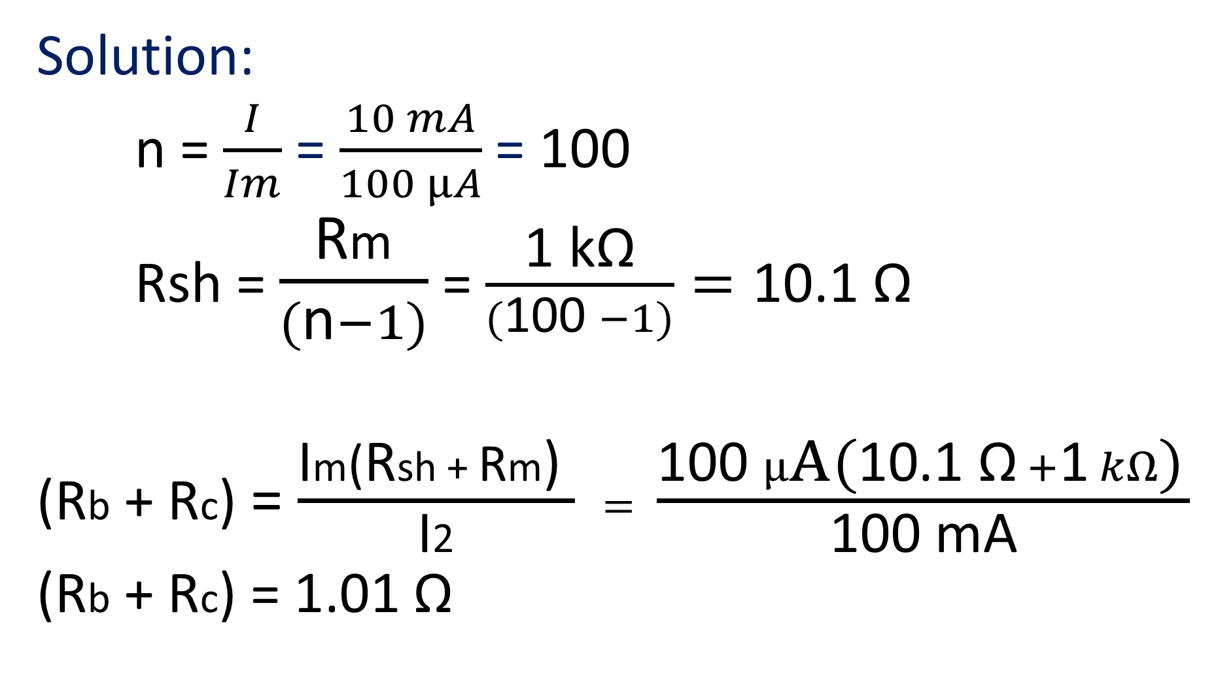
Solution:
n = $\frac{I}{Im}$ = $\frac{10 mA}{100 μA}$ = 100
Rsh = $\frac{\text{R}\text{m}}{(\text{n}−1)}$ = $\frac{\text{1} \text{k}\text{Ω}}{(\text{100 }−1)}=\text{10.1 }\text{Ω}$
(Rb + Rc) = $\frac{\text{I}\text{m}\text{(}\text{R}\text{sh}\text{ + }\text{R}\text{m}\text{) }}{\text{I}\text{2}} = \frac{\text{100 }μ\text{A}\text{ (}\text{10.1 }\text{Ω} +\text{1} kΩ\text{)} }{\text{100 }\text{mA}}$
(Rb + Rc) = 1.01 Ω

Slide 20
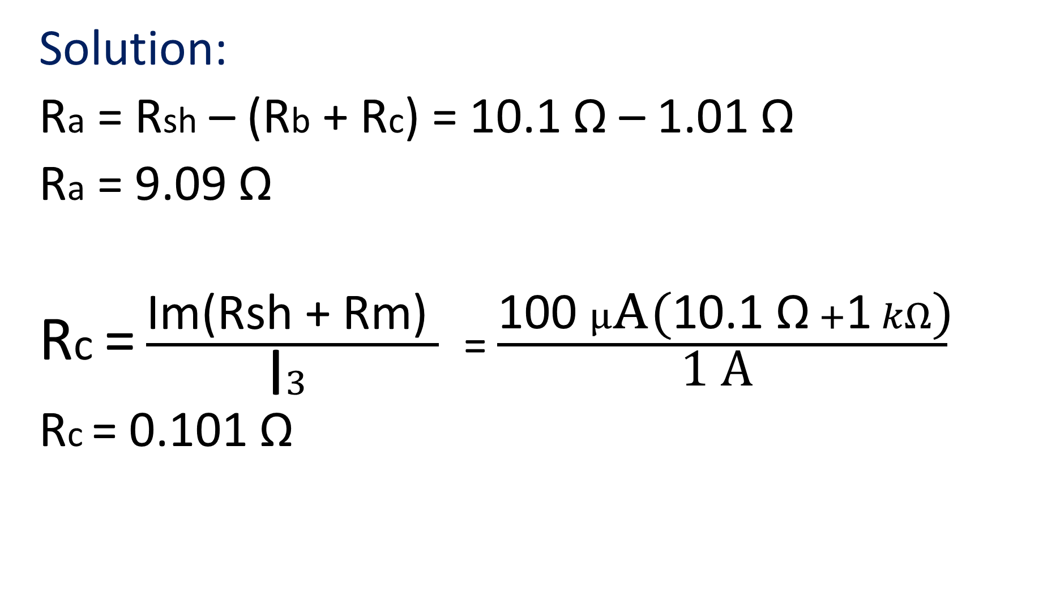
Solution:
Ra = Rsh – (Rb + Rc) = 10.1 Ω – 1.01 Ω
Ra = 9.09 Ω
Rc = $\frac{\text{Im}\text{(}\text{Rsh}\text{ + }\text{Rm}\text{) }}{\text{I}3 }$ = $\frac{\text{100 }μ\text{A}\text{ (}\text{10.1 }\text{Ω} +\text{1} kΩ\text{)}}{\text{1 }\text{A} }$
Rc = 0.101 Ω

Slide 21
Solution:
Rb = (Rb + Rc) – Rc = 1.01 Ω – 0.101Ω
Rb = 0.909 Ω
Rsh = Ra + Rb + Rc = 9.09 Ω + 0.909 Ω + 0.101 Ω
Rsh = 10.1 Ω

Slide 22
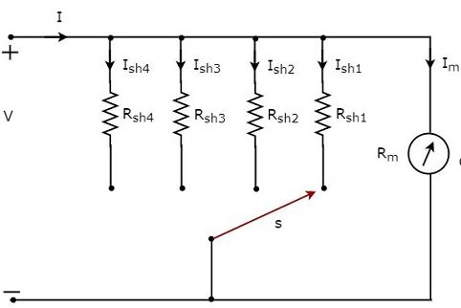

Multi Range Ammeter (parallel resistors)
n1 = $\frac{Ish₁}{Im}$ n2 = $\frac{Ish₂}{Im}$
n3 = $\frac{Ish₃}{Im}$ n4 = $\frac{Ish₄}{Im}$

Slide 23


Multi Range Ammeter (parallel resistors)
Rsh1 = $\frac{Rm}{(n₁ −1)}$
Rsh2 = $\frac{Rm}{(n₂ −1)}$
Rsh3 = $\frac{Rm}{(n₃ −1)}$
Rsh4 = $\frac{Rm}{(n₄ −1)}$

Slide 24
DC VOLTMETER
DC voltmeter is used to measure the dc voltage across any two points of electric circuit. If a resistor is placed in series with the Permanent Magnet Moving Coil (PMMC) galvanometer, then the entire combination together acts as a dc voltmeter.
The series resistance basically limits the amount of current that flows through the galvanometer in order to prevent the meter current from exceeding the full scale deflection value.

Slide 25
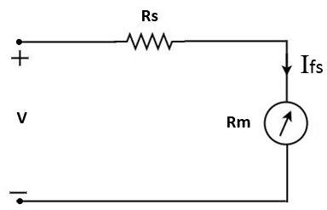
DC VOLTMETER
The basic d’Arsonval meter movement can be converted to a dc voltmeter by connecting a multiplier resistor, Rs in series with the meter movement.
Rs = multiplier resistor
Ifs = full scale
deflection
current

Slide 26

DC VOLTMETER
Sensitivity, S
S = $\frac{\text{1}}{\text{I}\text{fs}}$ (Ω/V)
Rs = S x Range - Rm

Slide 27
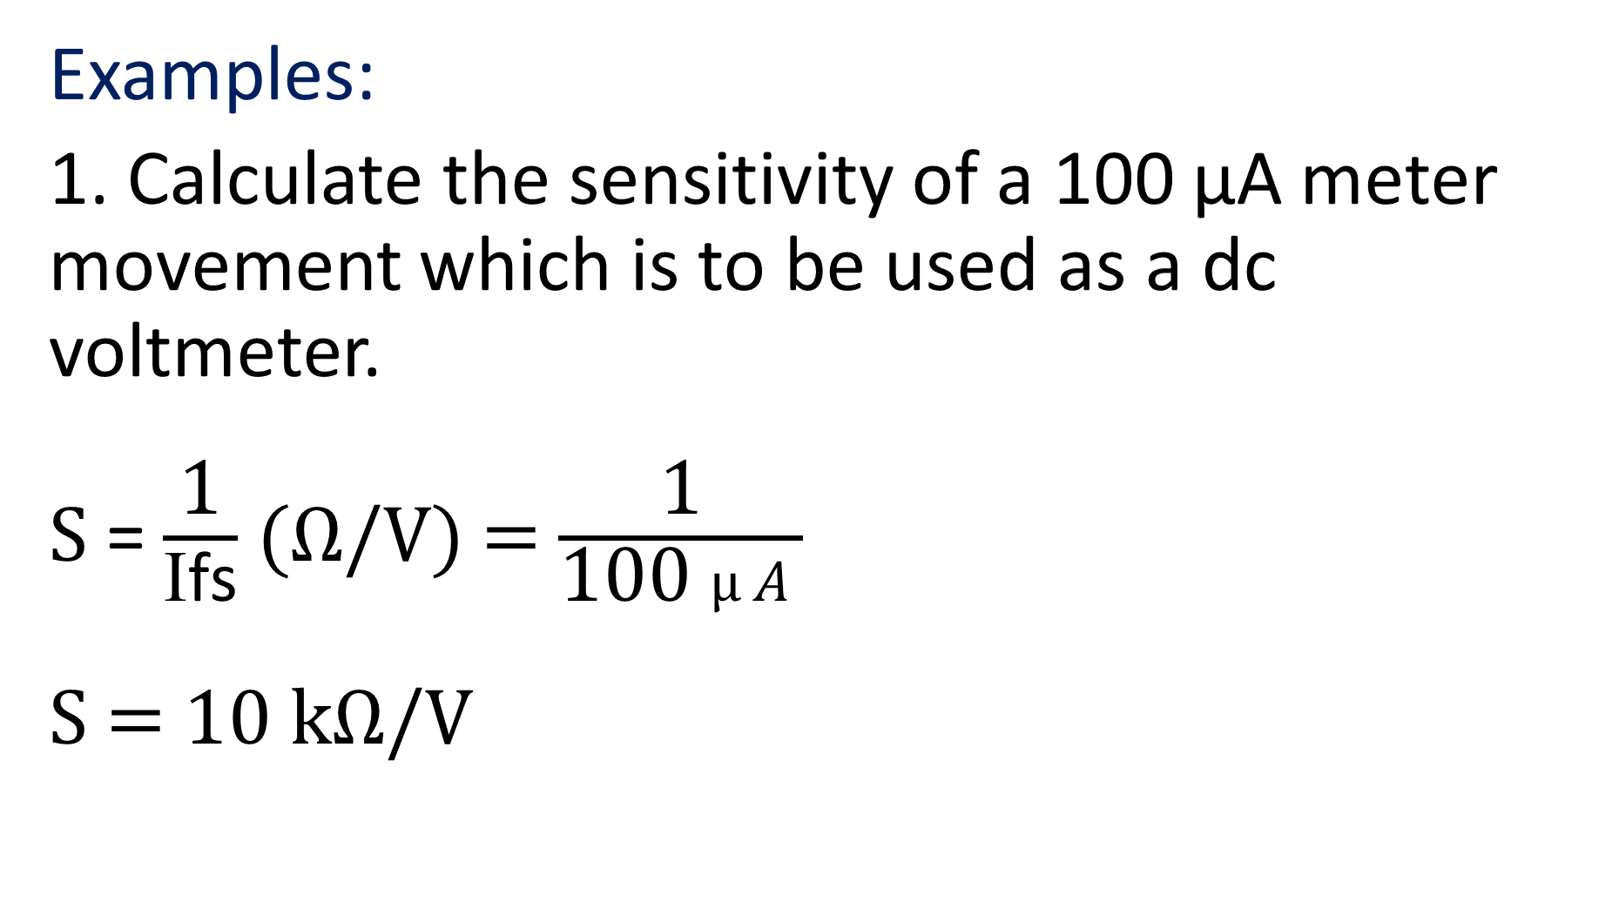
Examples:
1. Calculate the sensitivity of a 100 μA meter movement which is to be used as a dc voltmeter.
S = $\frac{\text{1}}{\text{I}\text{fs}}$ (Ω/V) = $\frac{\text{1}}{\text{100 }μA}$
S = 10 kΩ/V

Slide 28
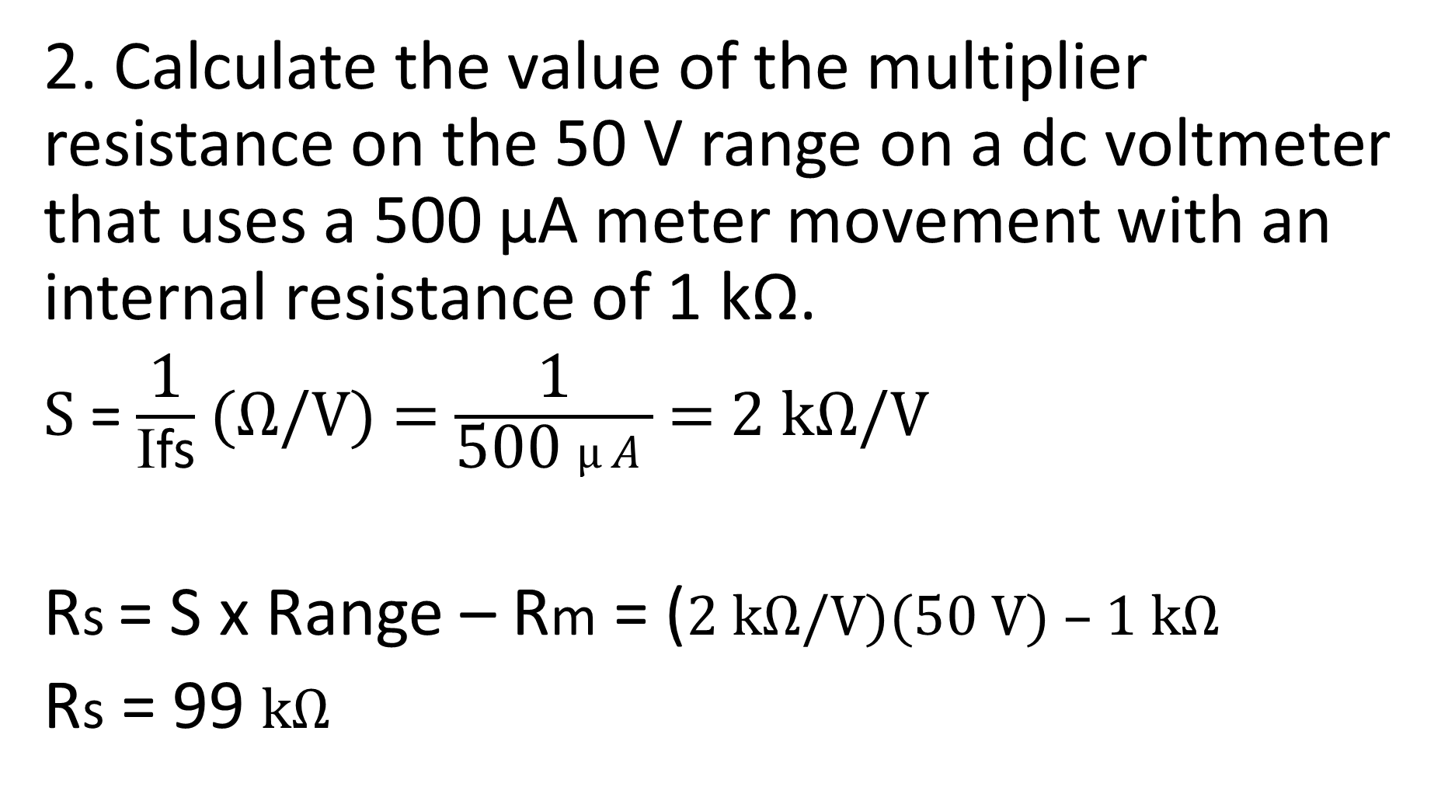
2. Calculate the value of the multiplier resistance on the 50 V range on a dc voltmeter that uses a 500 μA meter movement with an internal resistance of 1 kΩ.
S = $\frac{\text{1}}{\text{I}\text{fs}}$ (Ω/V) = $\frac{\text{1}}{\text{5}\text{00 }μA}$ = 2 kΩ/V
Rs = S x Range – Rm = (2 kΩ/V)(50 V) – 1 kΩ
Rs = 99 kΩ

Slide 29
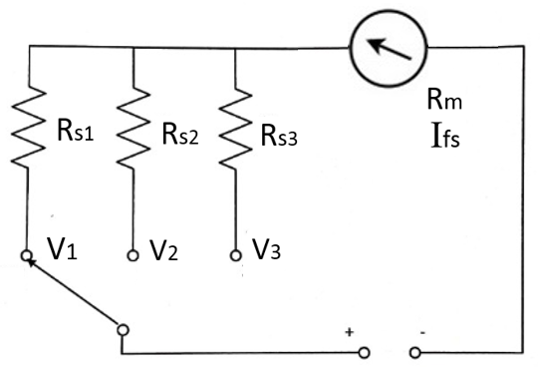
Multi Range Voltmeter (parallel resistors)
Rs1 = S x V1 – Rm
Rs2 = S x V2 – Rm
Rs3 = S x V3 – Rm

Slide 30
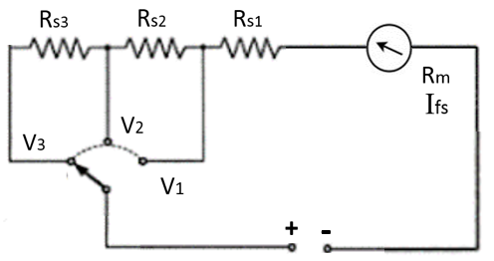
Multi Range Voltmeter (series resistors)
Rs1 = S x V1 – Rm
Rs2 = S x V2 – (Rs1 + Rm)
Rs3 = S x V3 – (Rs1 + Rs2 + Rm)

Slide 31
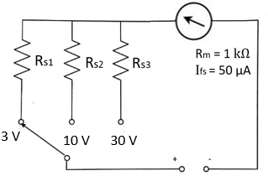

Examples:
S = $\frac{\text{1}}{\text{I}\text{fs}}$ = $\frac{\text{1}}{\text{50 }μA}$
S = 20 kΩ/V
Rs1 = S x V1 – Rm
Rs1 = (20 kΩ/V)(3 V) – 1 kΩ = 60 kΩ – 1 kΩ
Rs1 = 59 kΩ

Slide 32
Examples:
Rs2 = S x V2 – Rm
Rs2 = (20 kΩ/V)(10 V) – 1 kΩ = 200 kΩ – 1 kΩ
Rs2 = 199 kΩ
Rs3 = S x V3 – Rm
Rs3 = (20 kΩ/V)(30 V) – 1 kΩ = 600 kΩ – 1 kΩ
Rs3 = 599 kΩ

Slide 33
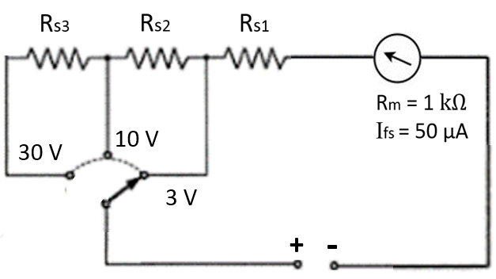
Examples:
S = $\frac{\text{1}}{\text{I}\text{fs}}$ = $\frac{\text{1}}{\text{50 }μA}$
S = 20 kΩ/V
Rs1 = S x V1 – Rm
Rs1 = (20 kΩ/V)(3 V) – 1 kΩ = 60 kΩ – 1 kΩ
Rs1 = 59 kΩ

Slide 34
Examples:
Rs2 = S x V2 – (Rs1 + Rm)
Rs2 = (20 kΩ/V)(10 V) – (59 kΩ + 1 kΩ)
Rs2 = 200 kΩ – 60 kΩ
Rs2 = 140 kΩ
Rs3 = S x V3 – (Rs1 + Rs2 + Rm)
Rs3 = (20 kΩ/V)(30 V) – (59 kΩ + 140 kΩ + 1 kΩ)
Rs3 = 600 kΩ – 200 kΩ
Rs3 = 400 kΩ

Slide 35
OHMMETER
The instrument, which is used to measure the value of resistance between any two points in an electric circuit is called ohmmeter. It can also be used to find the value of an unknown resistor.
Errors in Ohmmeter reading is usually due to battery voltage decay (battery aging).

Slide 36
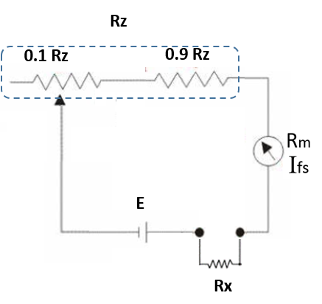

Ohmmeter
Shorted:
$\text{I}\text{fs}$ = $\frac{\text{E}}{\text{Rz}\text{ + }\text{Rm}}$ eq 1
With Rx load
$\text{I}$ = $\frac{\text{E}}{\text{Rz}\text{ + }\text{Rm}\text{ + }\text{Rx}}$ eq 2

Slide 37
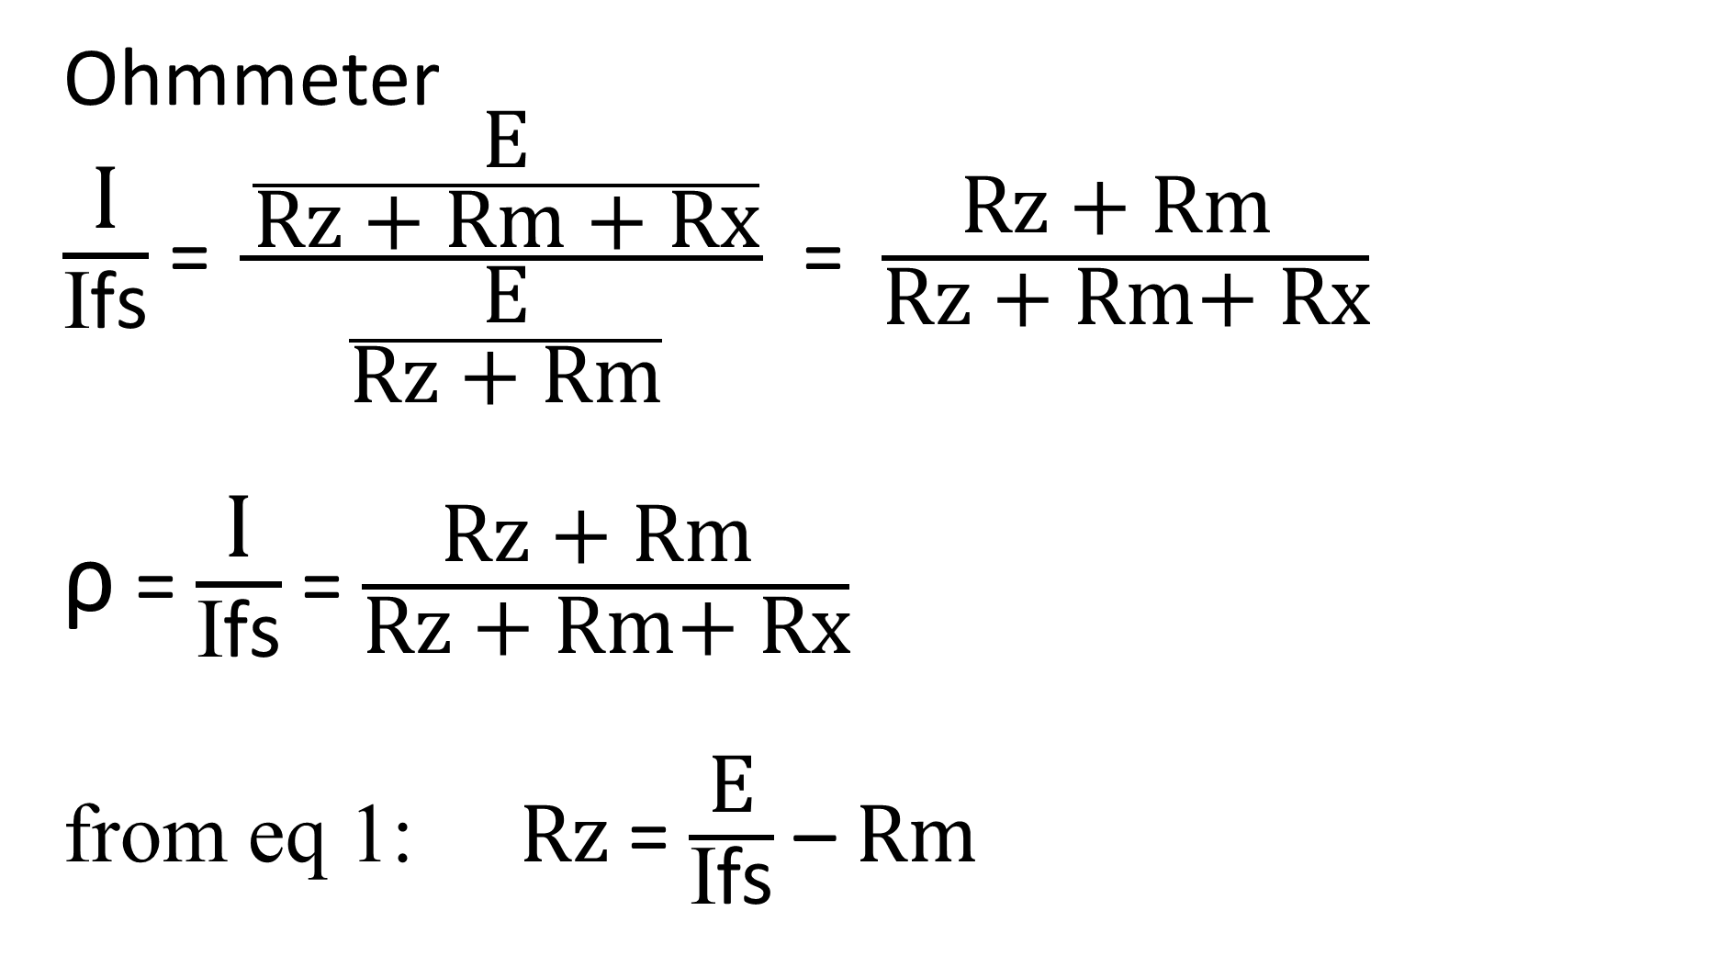
Ohmmeter
$\frac{\text{I}}{\text{I}\text{fs}}$ = $\frac{\frac{\text{E}}{\text{Rz}\text{ + }\text{Rm}\text{ + }\text{Rx}}}{\frac{\text{E}}{\text{Rz}\text{ + }\text{Rm}}}$ = $\frac{\text{Rz}\text{ + }\text{Rm} }{\text{Rz}\text{ + }\text{Rm}\text{+ }\text{Rx}}$
ρ = $\frac{\text{I}}{\text{I}\text{fs}}$ = $\frac{\text{Rz}\text{ + }\text{Rm} }{\text{Rz}\text{ + }\text{Rm}\text{+ }\text{Rx}}$
$\text{from} \text{eq}\text{ 1: }\text{Rz}$ = $\frac{\text{E}}{\text{I}\text{fs}}$ –$\text{Rm}$

Slide 38
Example
A 1 mA full scale deflection, current meter movement is to be used in an ohmmeter circuit. The meter movement has an internal resistance Rm of 100 Ω, and a 3 V battery will be used in the circuit. Mark off the meter face for reading resistance.

Slide 39
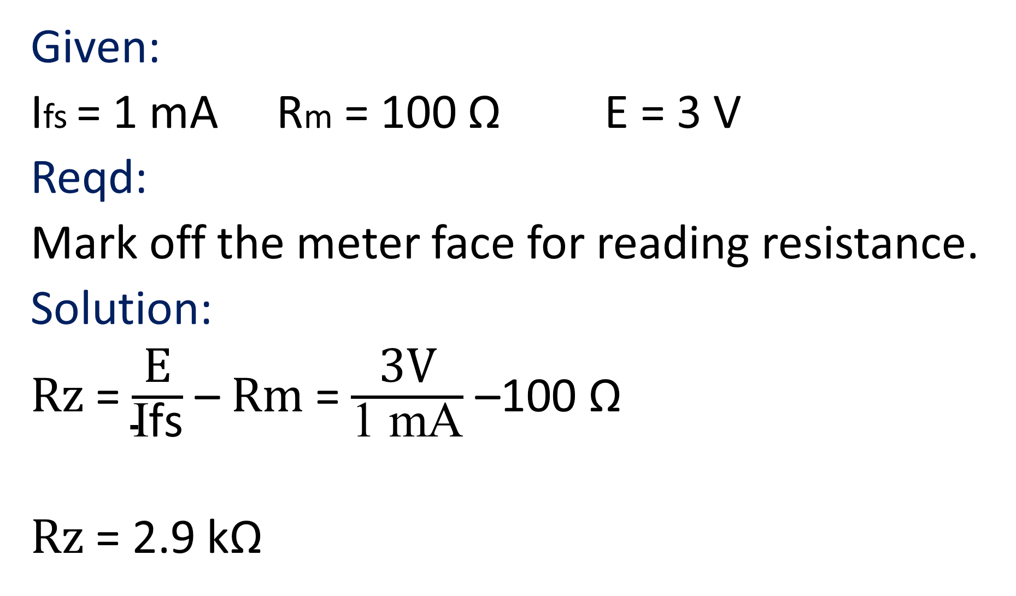
Given:
Ifs = 1 mA Rm = 100 Ω E = 3 V
Reqd:
Mark off the meter face for reading resistance.
Solution:
$\text{Rz}$ = $\frac{\text{E}}{\text{I}\text{fs}}$ –$\text{Rm}$ = $\frac{\text{3}\text{V}}{\text{1 }\text{mA}}$ –$\text{100 }\text{Ω}$
$\text{Rz}$ = 2.9 k$\text{Ω}$

Slide 40
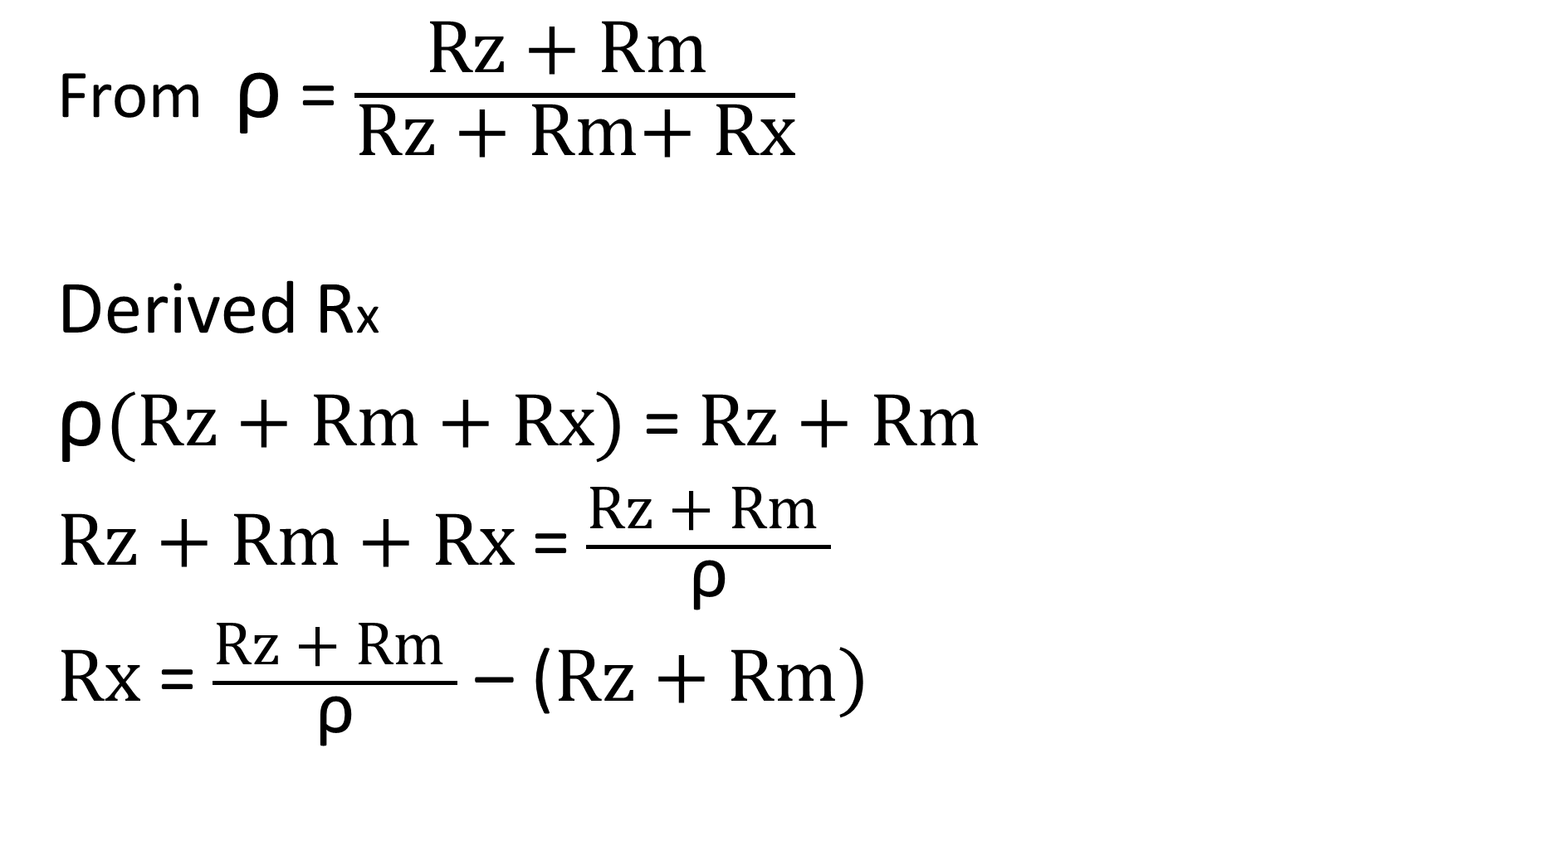
From ρ = $\frac{\text{Rz}\text{ + }\text{Rm} }{\text{Rz}\text{ + }\text{Rm}\text{+ }\text{Rx}}$
Derived Rx
ρ$\text{(}\text{Rz}\text{ + }\text{Rm}\text{ + }\text{Rx}\text{)}$= $\text{Rz}\text{ + }\text{Rm}$
$\text{Rz}\text{ + }\text{Rm}\text{ + }\text{Rx}$= $\frac{\text{Rz}\text{ + }\text{Rm} }{\text{ρ}}$
$\text{Rx}$= $\frac{\text{Rz}\text{ + }\text{Rm} }{\text{ρ}}$ – ($\text{Rz}\text{ + }\text{Rm}\text{)}$

Slide 41
The value of Rx with 20% full scale deflection is:
$\text{Rx}$= $\frac{\text{Rz}\text{ + }\text{Rm} }{\text{ρ}}$ – ($\text{Rz}\text{ + }\text{Rm}\text{)}$
$\text{Rx}$= $\frac{\text{2.9 }\text{k}\text{Ω} \text{+}\text{100 }\text{Ω}}{\text{0.2}}$ – ($\text{2.9 }\text{k}\text{Ω} \text{+}\text{100 }\text{Ω}\text{)}$
$\text{Rx}$= 12 $\text{k}\text{Ω}$

Slide 42
The value of Rx with 40% full scale deflection is:
$\text{Rx}$= $\frac{\text{Rz}\text{ + }\text{Rm} }{\text{ρ}}$ – ($\text{Rz}\text{ + }\text{Rm}\text{)}$
$\text{Rx}$= $\frac{\text{2.9 }\text{k}\text{Ω} \text{+}\text{100 }\text{Ω}}{\text{0.4}}$ – ($\text{2.9 }\text{k}\text{Ω} \text{+}\text{100 }\text{Ω}\text{)}$
$\text{Rx}$= 4.5 $\text{k}\text{Ω}$

Slide 43
The value of Rx with 50% full scale deflection is:
$\text{Rx}$= $\frac{\text{Rz}\text{ + }\text{Rm} }{\text{ρ}}$ – ($\text{Rz}\text{ + }\text{Rm}\text{)}$
$\text{Rx}$= $\frac{\text{2.9 }\text{k}\text{Ω} \text{+}\text{100 }\text{Ω}}{\text{0.5}}$ – ($\text{2.9 }\text{k}\text{Ω} \text{+}\text{100 }\text{Ω}\text{)}$
$\text{Rx}$= 3 $\text{k}\text{Ω}$

Slide 44
The value of Rx with 75% full scale deflection is:
$\text{Rx}$= $\frac{\text{Rz}\text{ + }\text{Rm} }{\text{ρ}}$ – ($\text{Rz}\text{ + }\text{Rm}\text{)}$
$\text{Rx}$= $\frac{\text{2.9 }\text{k}\text{Ω} \text{+}\text{100 }\text{Ω}}{\text{0.75}}$ – ($\text{2.9 }\text{k}\text{Ω} \text{+}\text{100 }\text{Ω}\text{)}$
$\text{Rx}$= 1 $\text{k}\text{Ω}$

Slide 45
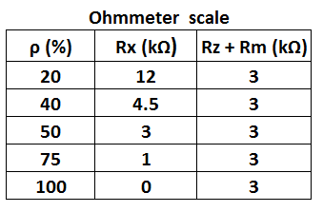
Tabulated value for the Ohmmeter scale

Slide 46
In Ammeters the lower the meter resistance the better. Ideal Ammeters will have zero internal resistance.
In Voltmeters the higher the meter resistance the better. Ideal Voltmeters will have infinite internal resistance.
In Ohmmeters the meter internal resistance is not a big factor for accuracy, it is the battery.

Slide 47
Errors in Ammeter reading is due to insertion effects.
Errors in Voltmeter reading is due to loading effects.
Errors in Ohmmeter reading is usually due to battery voltage decay.

Slide 48
The basic D’Arsonval meter movement is a current sensitive device capable of directly measuring only very small currents. Large current can be measured by adding shunts.
Voltages can be measured by adding multipliers.
Resistance can be measured by adding a battery and a resistance network.
$$\text{(}$$

